Slide 1
Fast food Marketing campaign A/B test
By Parkhat Bazakov
Last updated: 3/01/2023

Slide 2
Objective
Determine which of three promotion types is most effective in relationship to size and age of the mall during four weeks.

Slide 3
Data source
Secondary data
Taken from Kaggle.com
https://www.kaggle.com/datasets/chebotinaa/fast-food-marketing-campaign-ab-test

Slide 4
Steps taken
Data visualisation with Power BI to gain insights

Slide 5
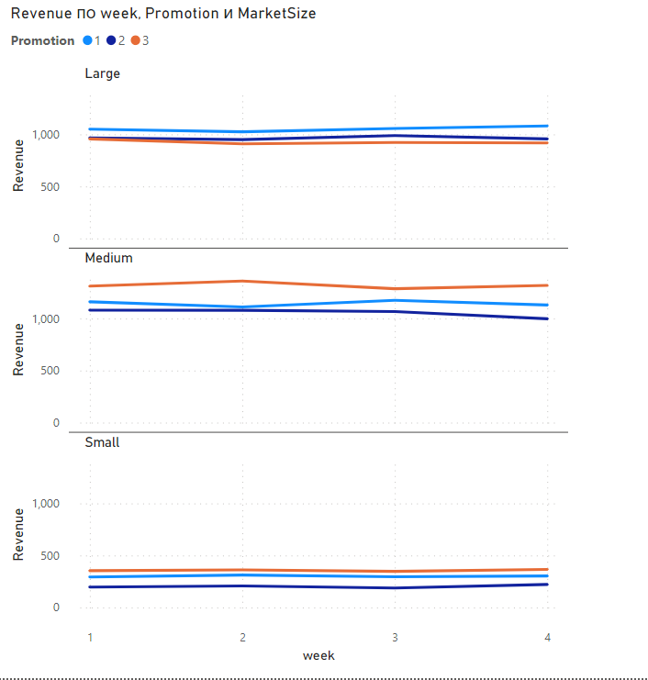
Results
Promotion 1 was the most effective in Large stores.
Promotion 3 was the most effective in Medium and Small stores.
Promotion 2 was second most effective in Large stores.

Slide 6
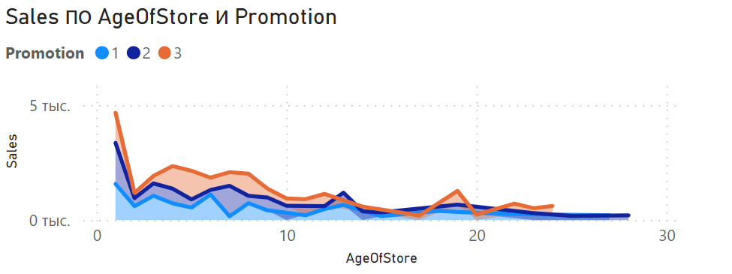
Stores of the age zero showed higher promotion effectiveness.
Effectiveness of promotions declines with the age of the store.
Promotion 3 is shown to be most effective across the age groups.

Slide 7
Conclusion
Given data shows that Promotions 1 and 3 yielded the most results.
Amount of the revenue without the promotions is needed in order to compare the the effect of promotions vs no promotion.

